Slide 1

Water Quality Prediction
Sucharitha Puppala
Data Science, Bellevue University.
DSC680-T301 Applied Data Science (2233-1)
Professor Catherine Williams.
February 5,2023

Slide 2
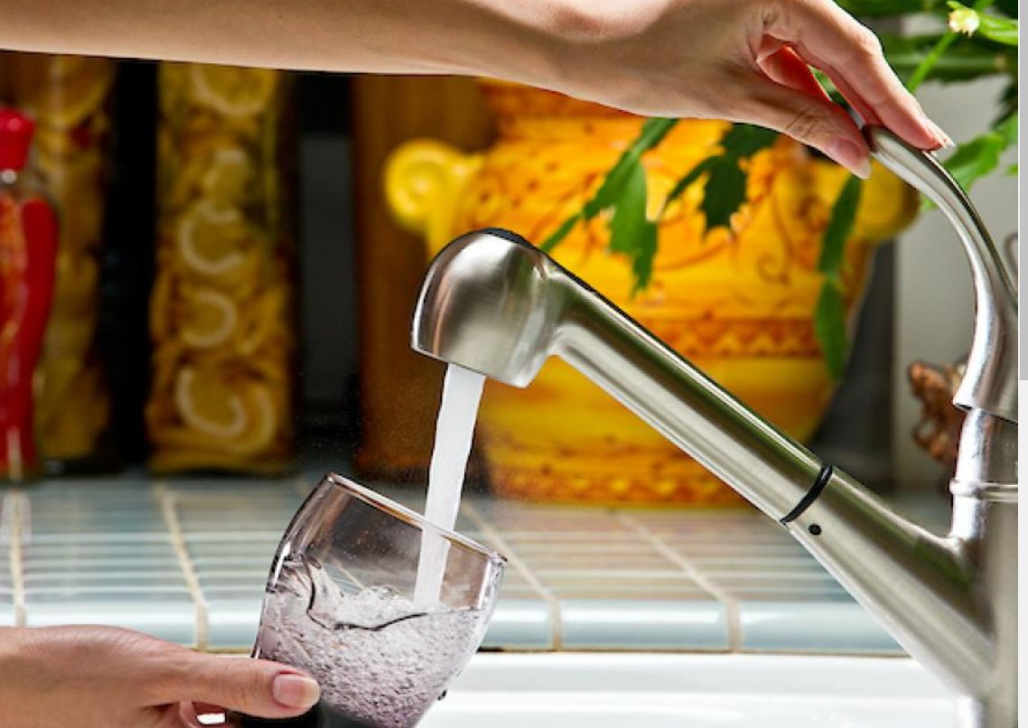
Introduction
Potable water
also known as drinking water.

Slide 3
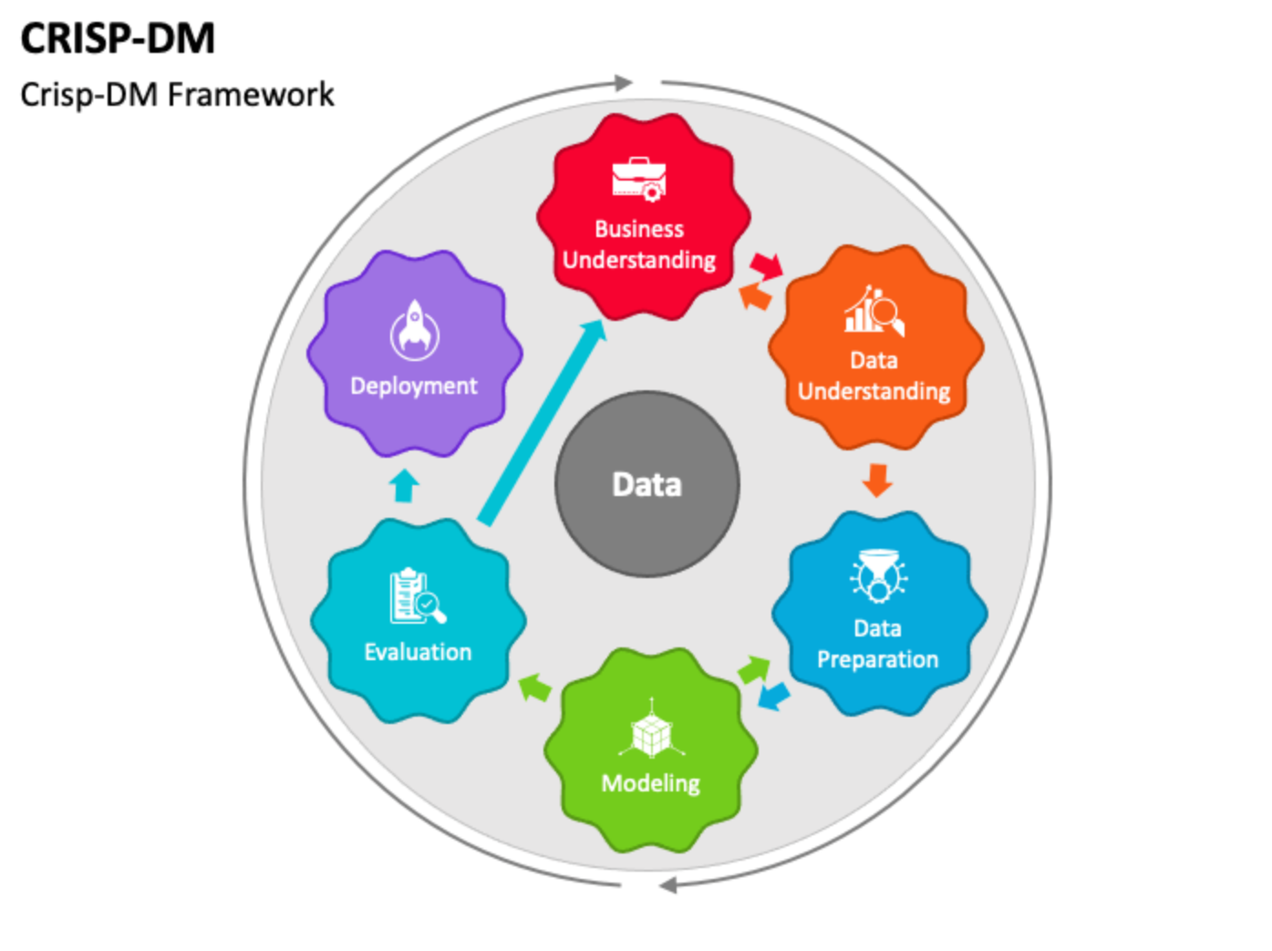

Methodology

Slide 4
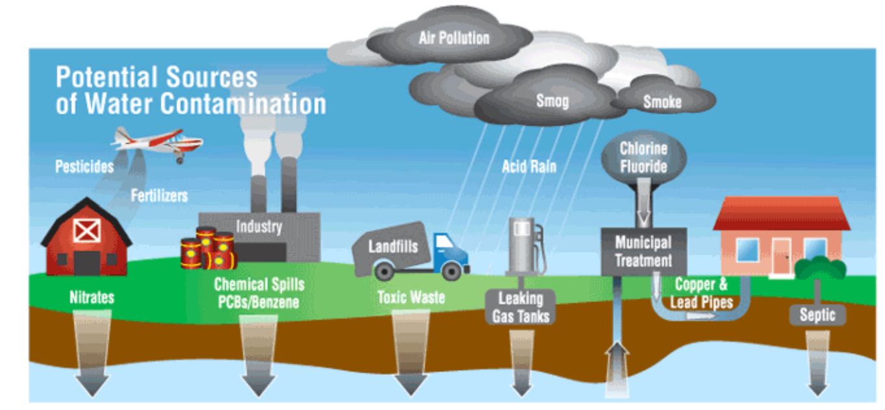
Business Understanding
Project ----> identifying the machine learning model that best fits in predicting the water quality.

Slide 5
Data Understanding 1. Dataset Source
Variables in the dataset
pH value
Hardness
Solids (Total dissolved solids - TDS)
Chloramines
Sulfate
Conductivity
Organic carbon
Trihalomethanes
Turbidity
Data Set Source
Kaggle.com
Potability ---→ TARGET VARIABLE

Slide 6
Data Understanding 2. Overview of the dataset
Data set Size → 3276 rows and 10 columns
Null values → ph, Sulfates and trihalomethanes
Null values → Replaced with mean
Duplicates → no

Slide 7
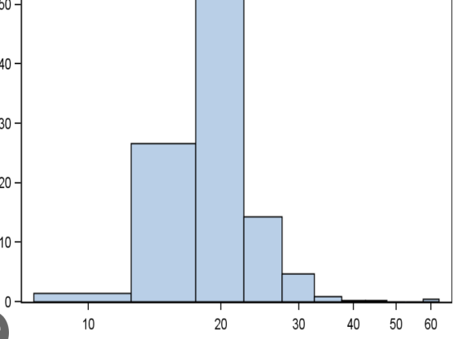
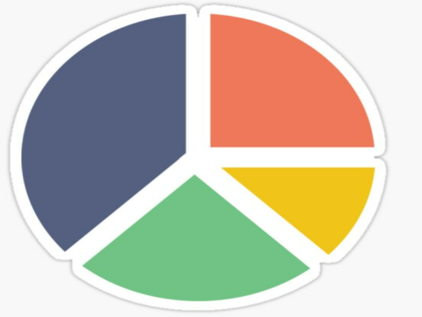
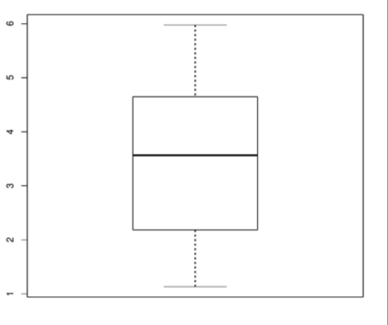
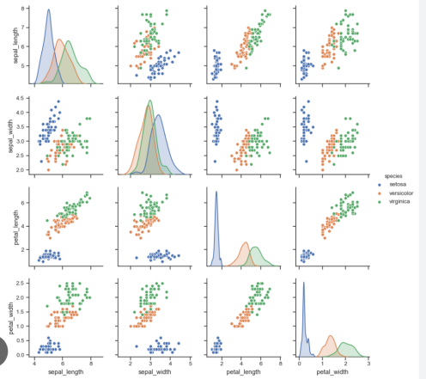
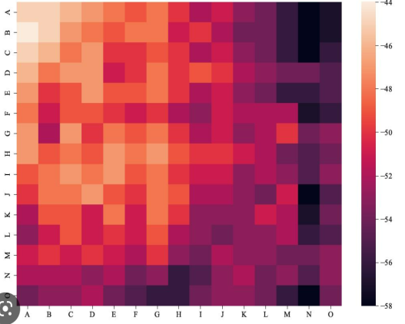
Data Understanding 3.Data Exploration

Slide 8
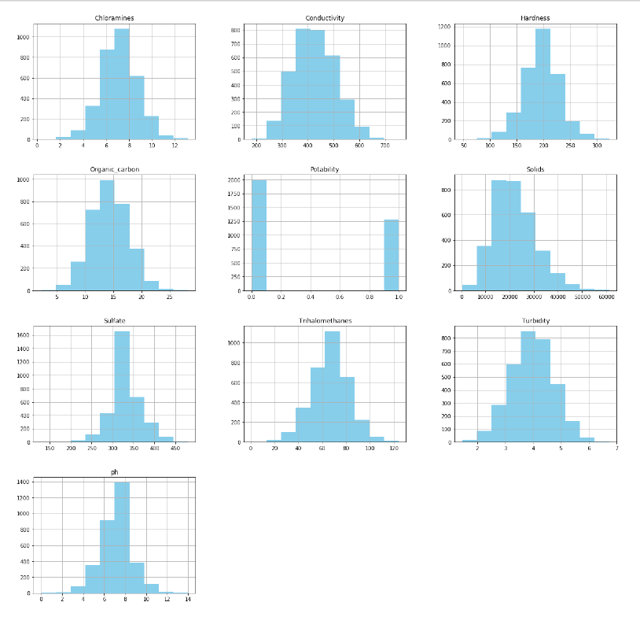
Data Understanding 3.Data Exploration
Histogram of the numerical variables of the dataset.

Slide 9
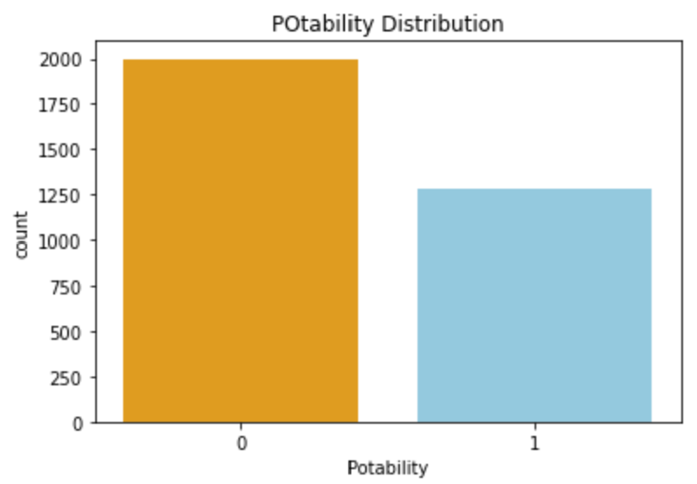
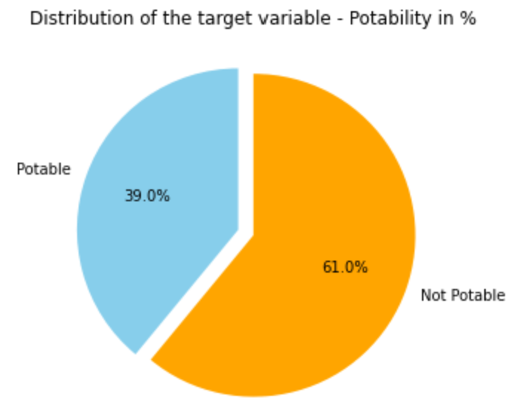
Data Understanding 3.Data Exploration
Distribution of the target variable
“Potability”

Slide 10
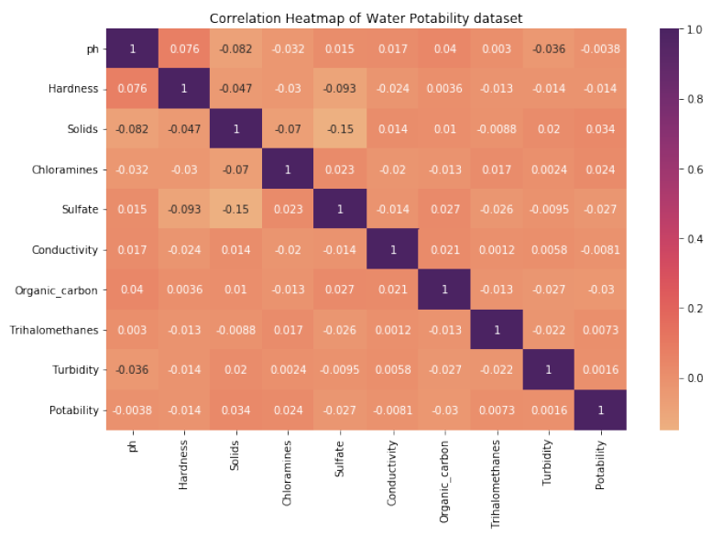
Data Understanding
Correlation Heatmap of Water Quality dataset

Slide 11
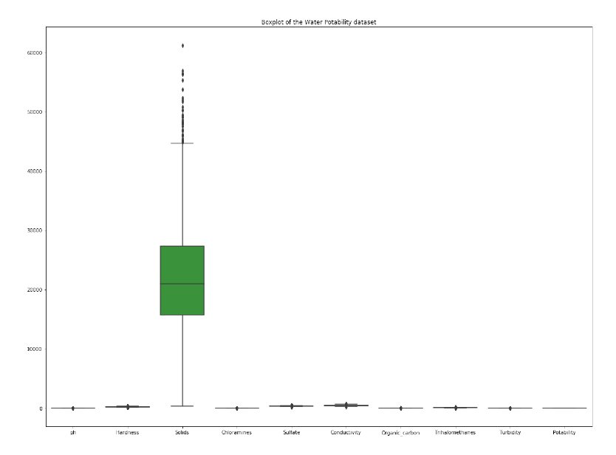
Data Preparation
Identification of outliers → boxplot
Removal of the outliers →Inter Quartile Range(IQR) method

Slide 12
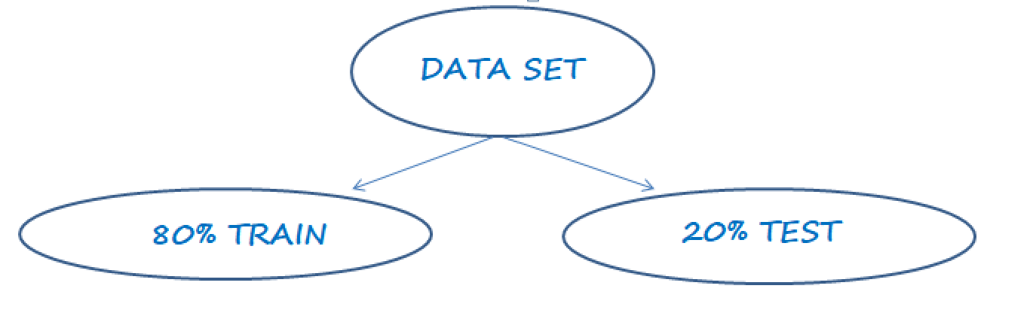
Data Preparation
Target Variable → ”Potability”
Test Size - 0.2
Random State - 42

Slide 13
Modeling
As the project focuses on classification the following models are selected for this project:
K – Nearest Neighbor Classifier
Random Forest Classifier
XGB Classifier

Slide 14
Evaluation
Evaluation metrics used are as follows
Accuracy
Precision
Recall
F1 Score

Slide 15
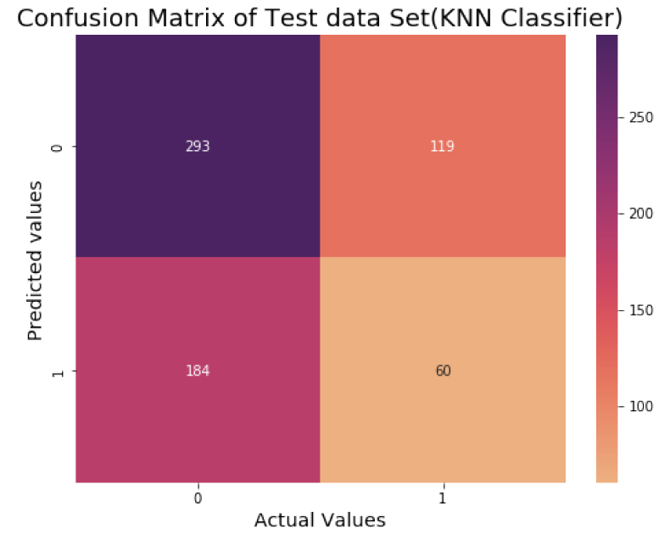
Evaluation
KNN Classifier :
Accuracy → 0.53 (53%)
Precision → 0.335
Recall Score → 0.246
F 1 Score → 0.284

Slide 16
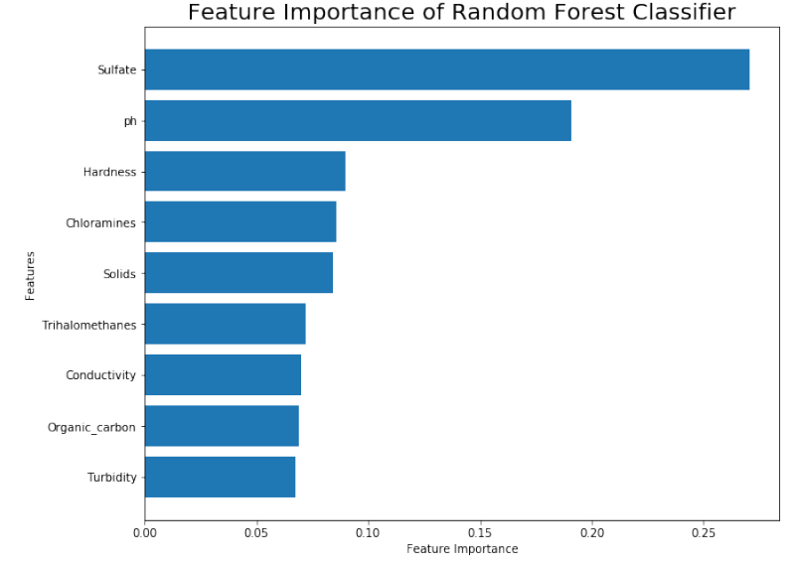
Evaluation
Random Forest Classifier:
Accuracy → 0.807 (nearly 81%)
Precision → 0.811
Recall Score → 0.631
F 1 Score → 0.71

Slide 17
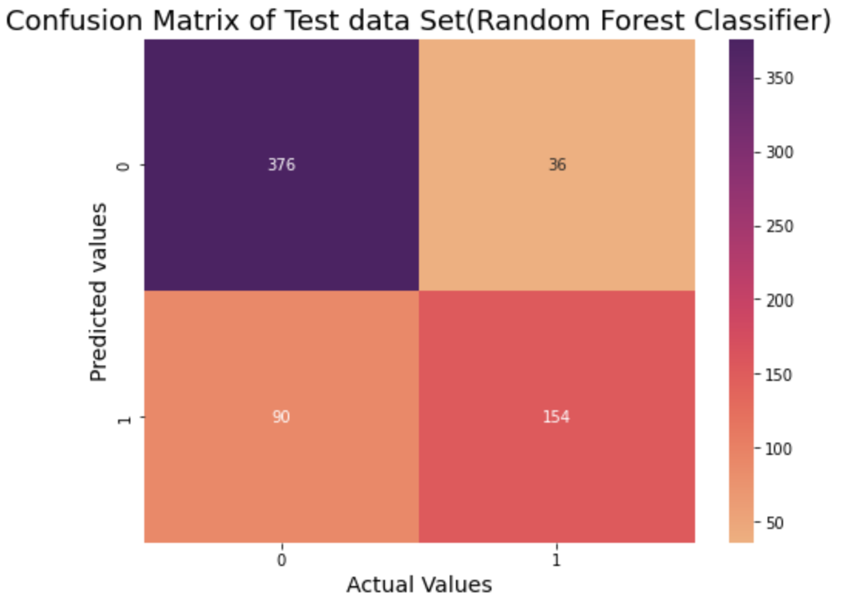
Evaluation

Slide 18
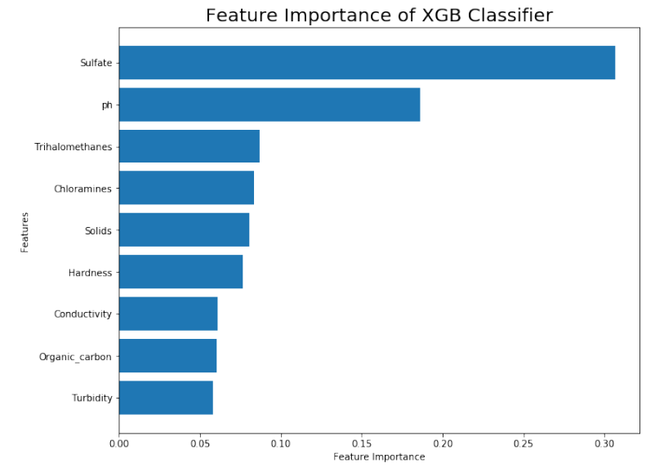
Evaluation
XGB Classifier :
Accuracy → 0.801 (80%)
Precision → 0.701
Recall Score → 0.68
F 1 Score → 0.719

Slide 19
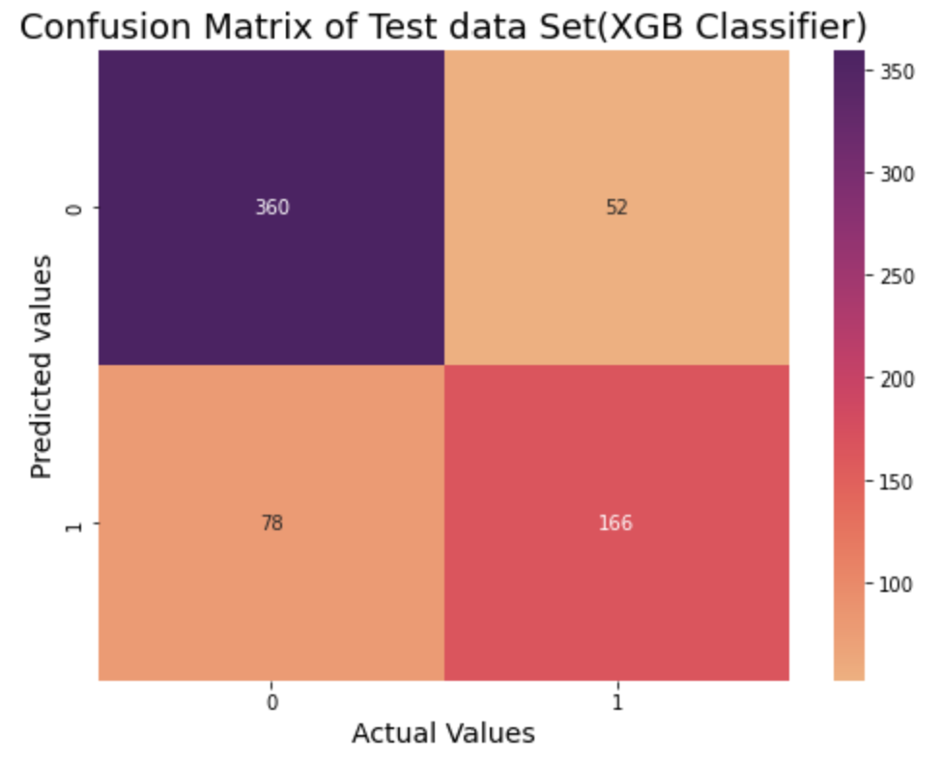
Evaluation

Slide 20
Deployment
Random Forest Classifier and XGB Classifier → not recommended for deployment
However these models can be used for understanding the features that are more responsible for the predicting the water quality of different sources of water.

Slide 21
Conclusion
Best model → Random Forest Classifier and XGB Classifier
Features → Sulfate and ph

Slide 22
Ethical Considerations
Ethical considerations while handling the water data are
Transparency
justice and fairness
responsibility
accountability

Slide 23
References
Kaggle.com, Diabetes dataset, https://www.kaggle.com/datasets/akshaydattatraykhare/diabetes-dataset
Google, Wastewater Digest, https://www.wwdmag.com/editorial-topical/what-is-articles/article/10940236/what-is-potable-water
Google, c and j water softeners, The importance of water quality testing, https://candjwater.com/2022/02/01/the-importance-of-water-quality-testing/
Google, Using Machine Learning Models for Predicting the Water Quality Index in the La Buong River, Vietnam, https://www.mdpi.com/2073-4441/14/10/1552
Google, KDNuggets, More Performance Evaluation Metrics for Classification Problems You Should Know, Clare Liu, Fintech Industry on September 20, 2022 in Machine Learning,
https://www.kdnuggets.com/2020/04/performance-evaluation-metrics-classification.html#:~:text=The%20key%20classification%20metrics%3A%20Accuracy,Receiver%20Operating%20Characteristic%20(ROC)%20curve
Google, https://waterpitch.com/pages/learning-center

Slide 24
Thank You

